Slide 1
Autophotographer project
Tom Paganuzzi – top9

Slide 2
What is an autophotographer, anyway?
Selecting the best images from a large set
Modular
Rules of Thumb:
  Symmetry
  Contrast
  Rule of Thirds
Mention photographer friend

Slide 3
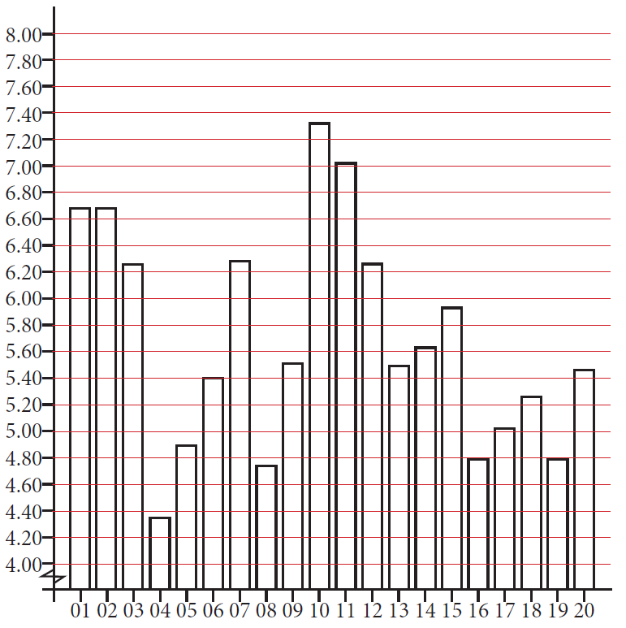
Preliminary Research
Google Forms
20 photos, all mine
Variety – Good + Bad
Different compositions
  Landscapes
  Portraits
Comments section
Use graphs on Google Docs, don’t scroll through all of them though.

Slide 4
symmetry.py
Talk about what symmetry.py does

Slide 5
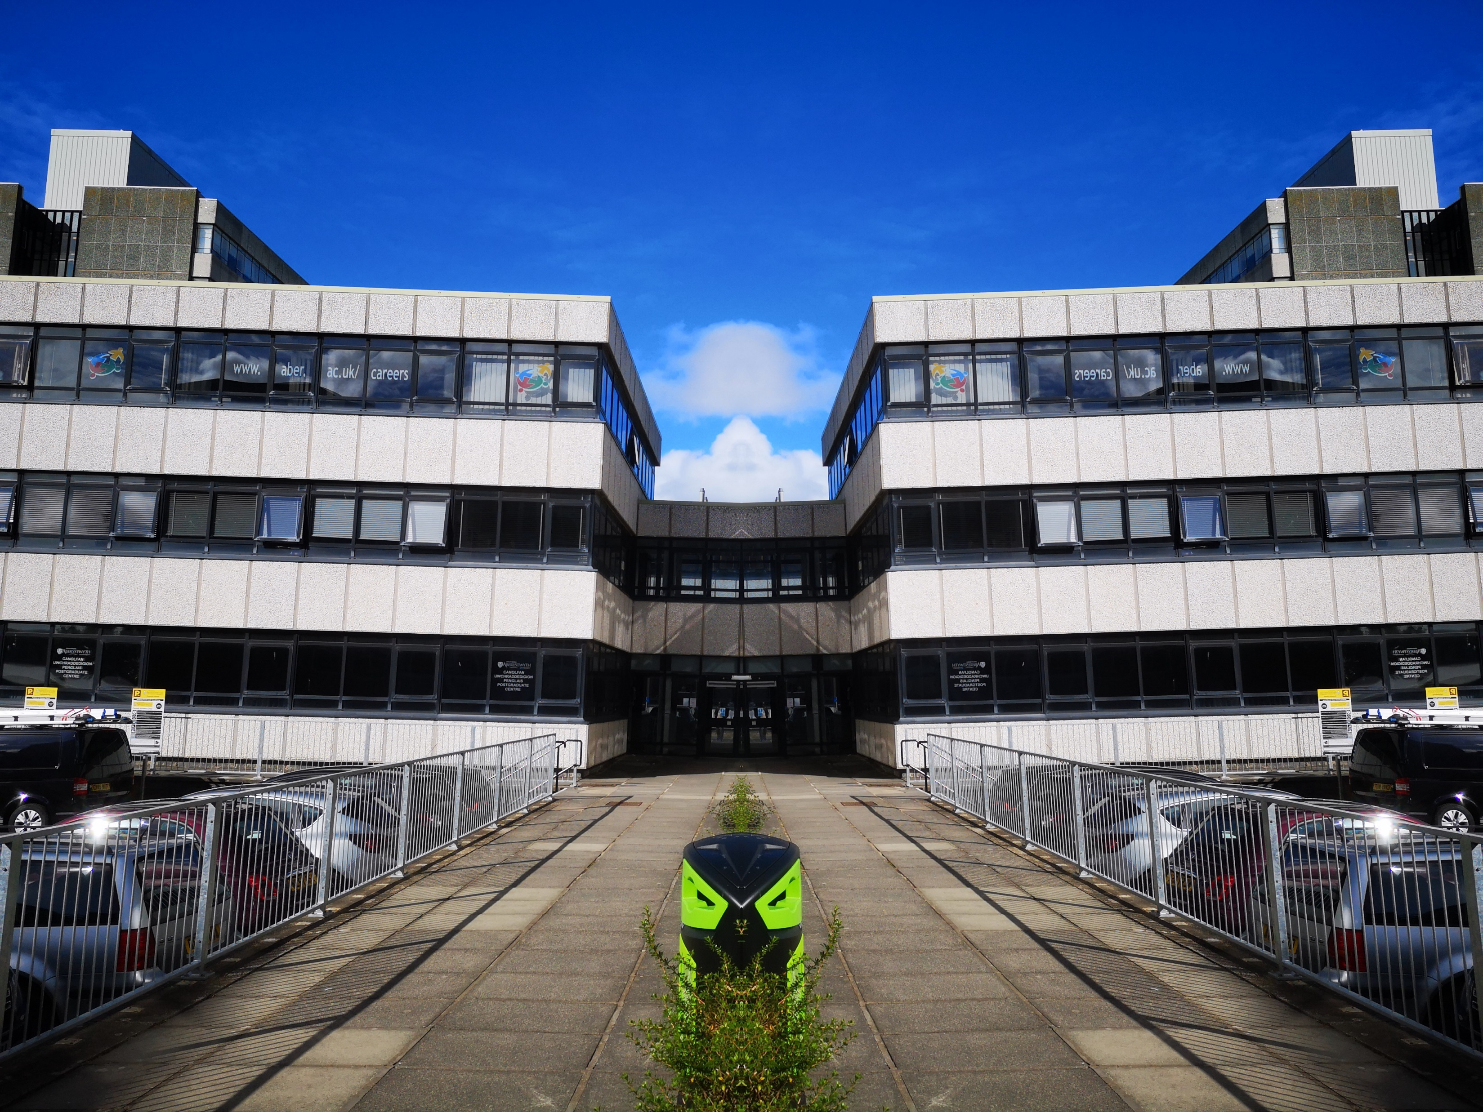
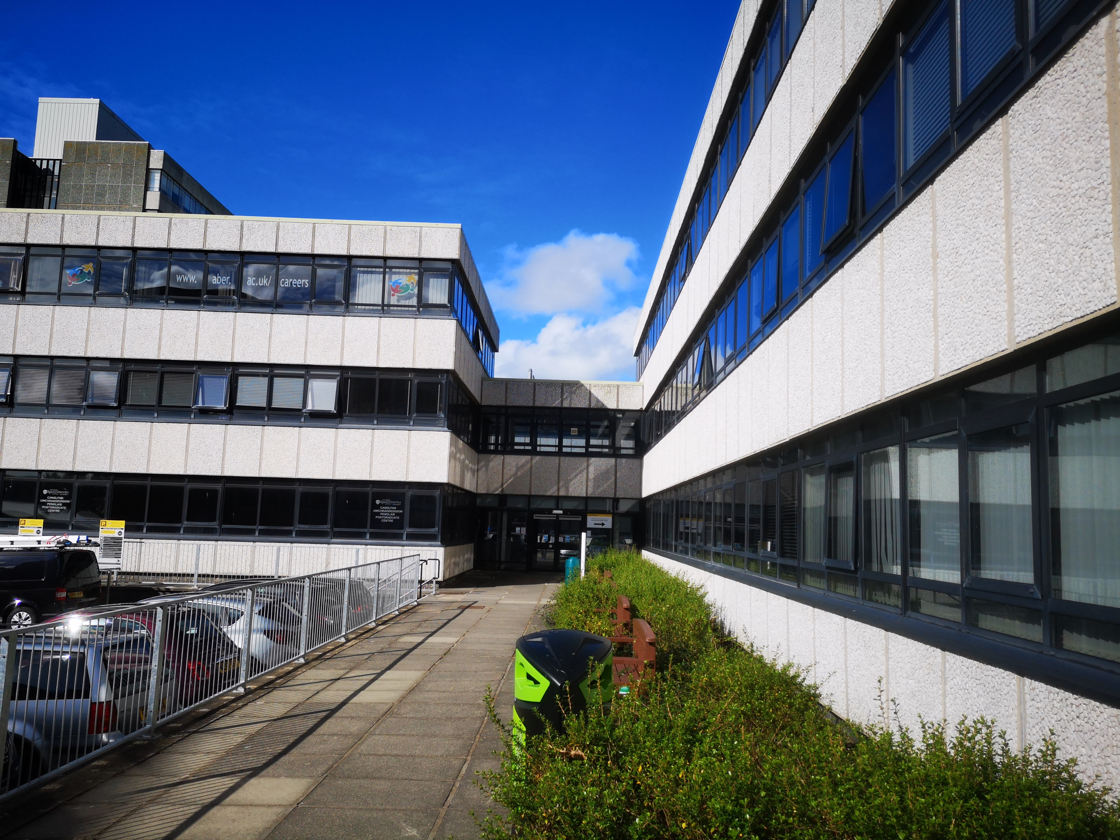
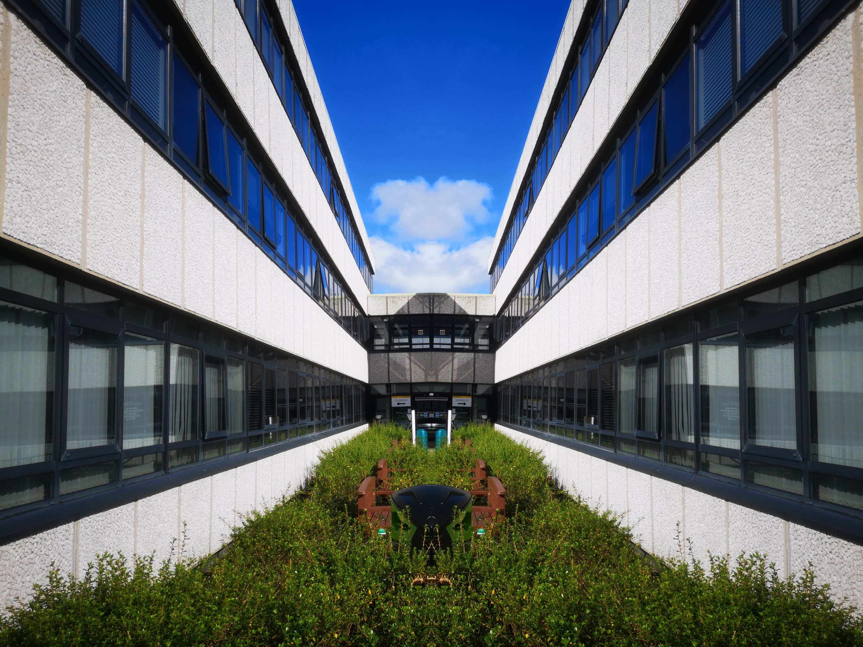
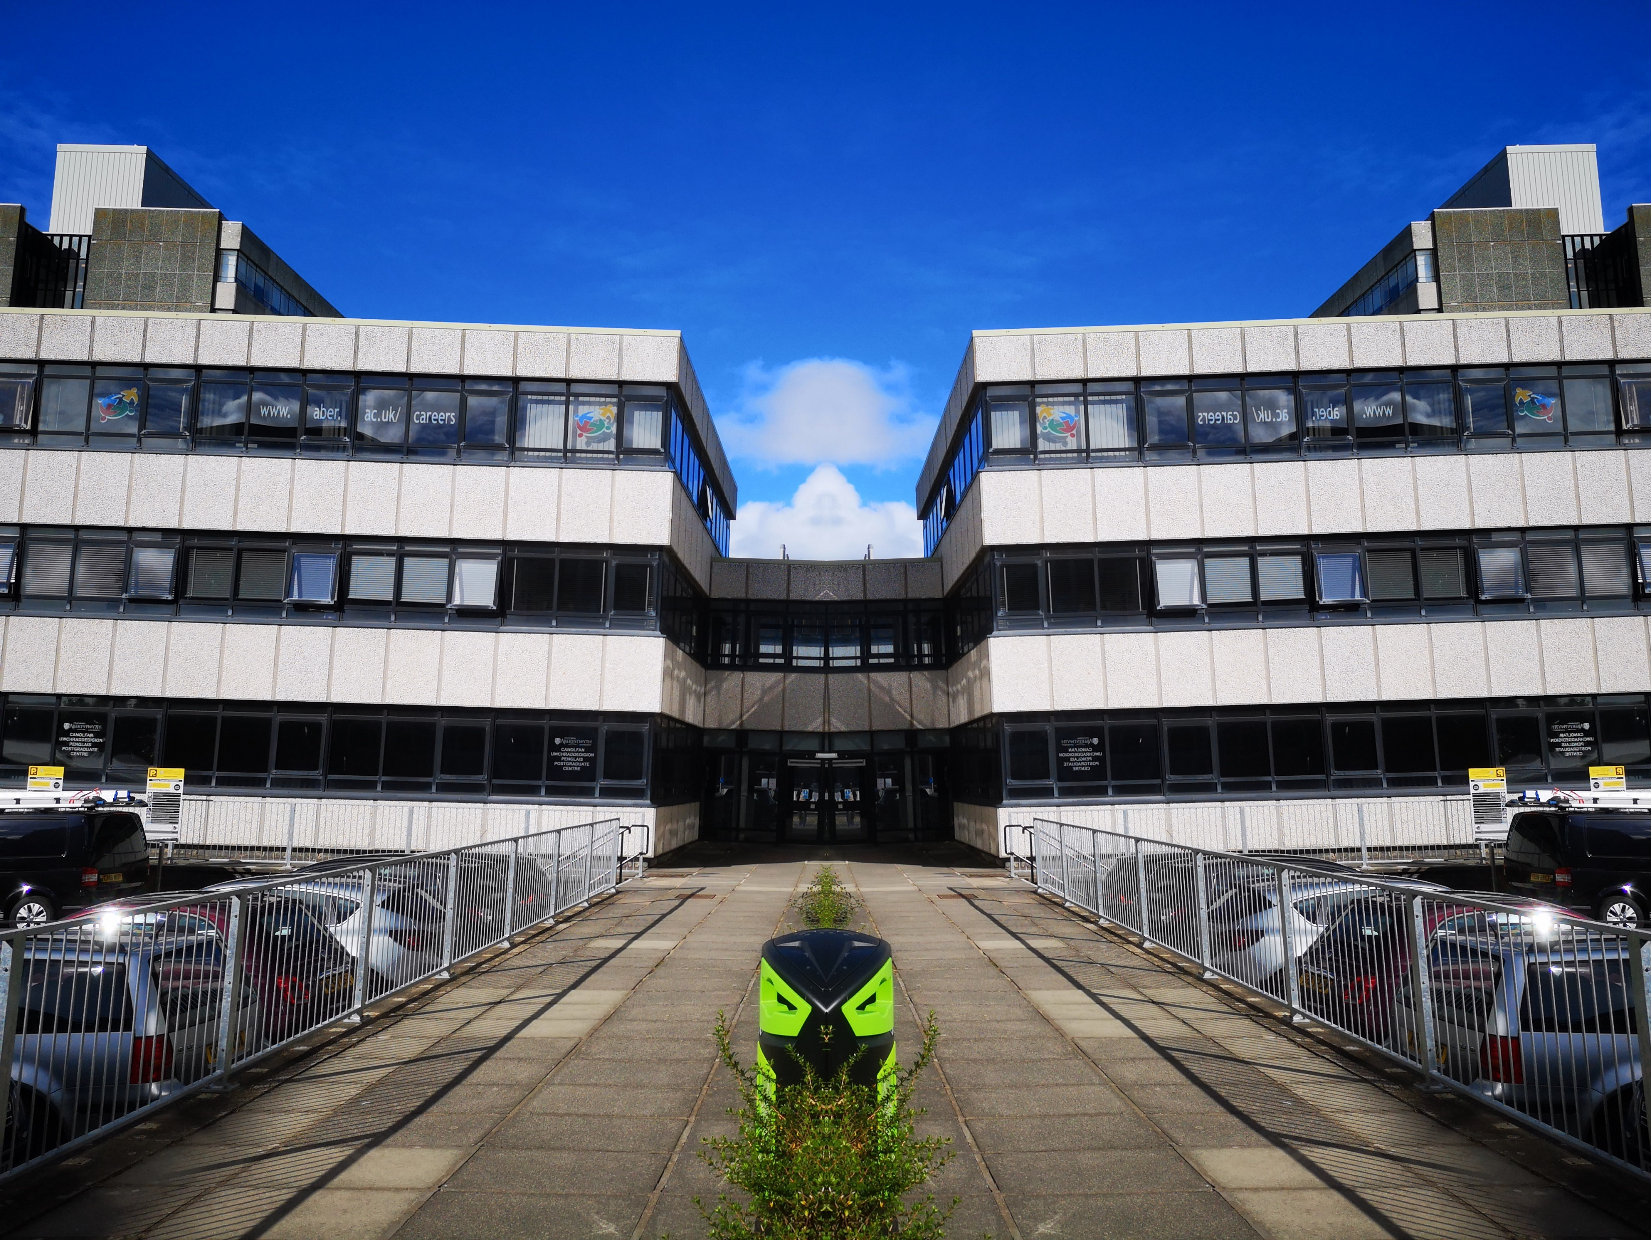
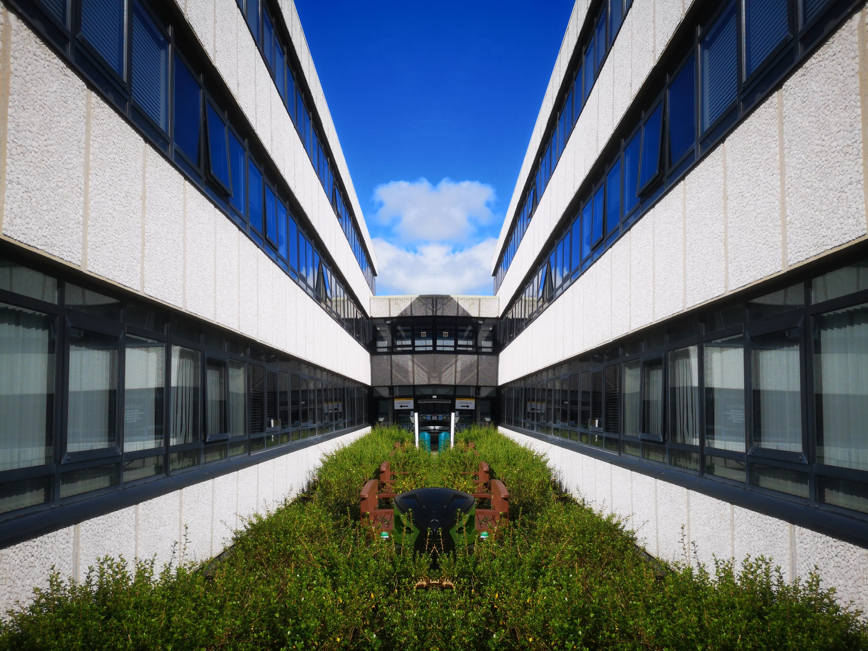
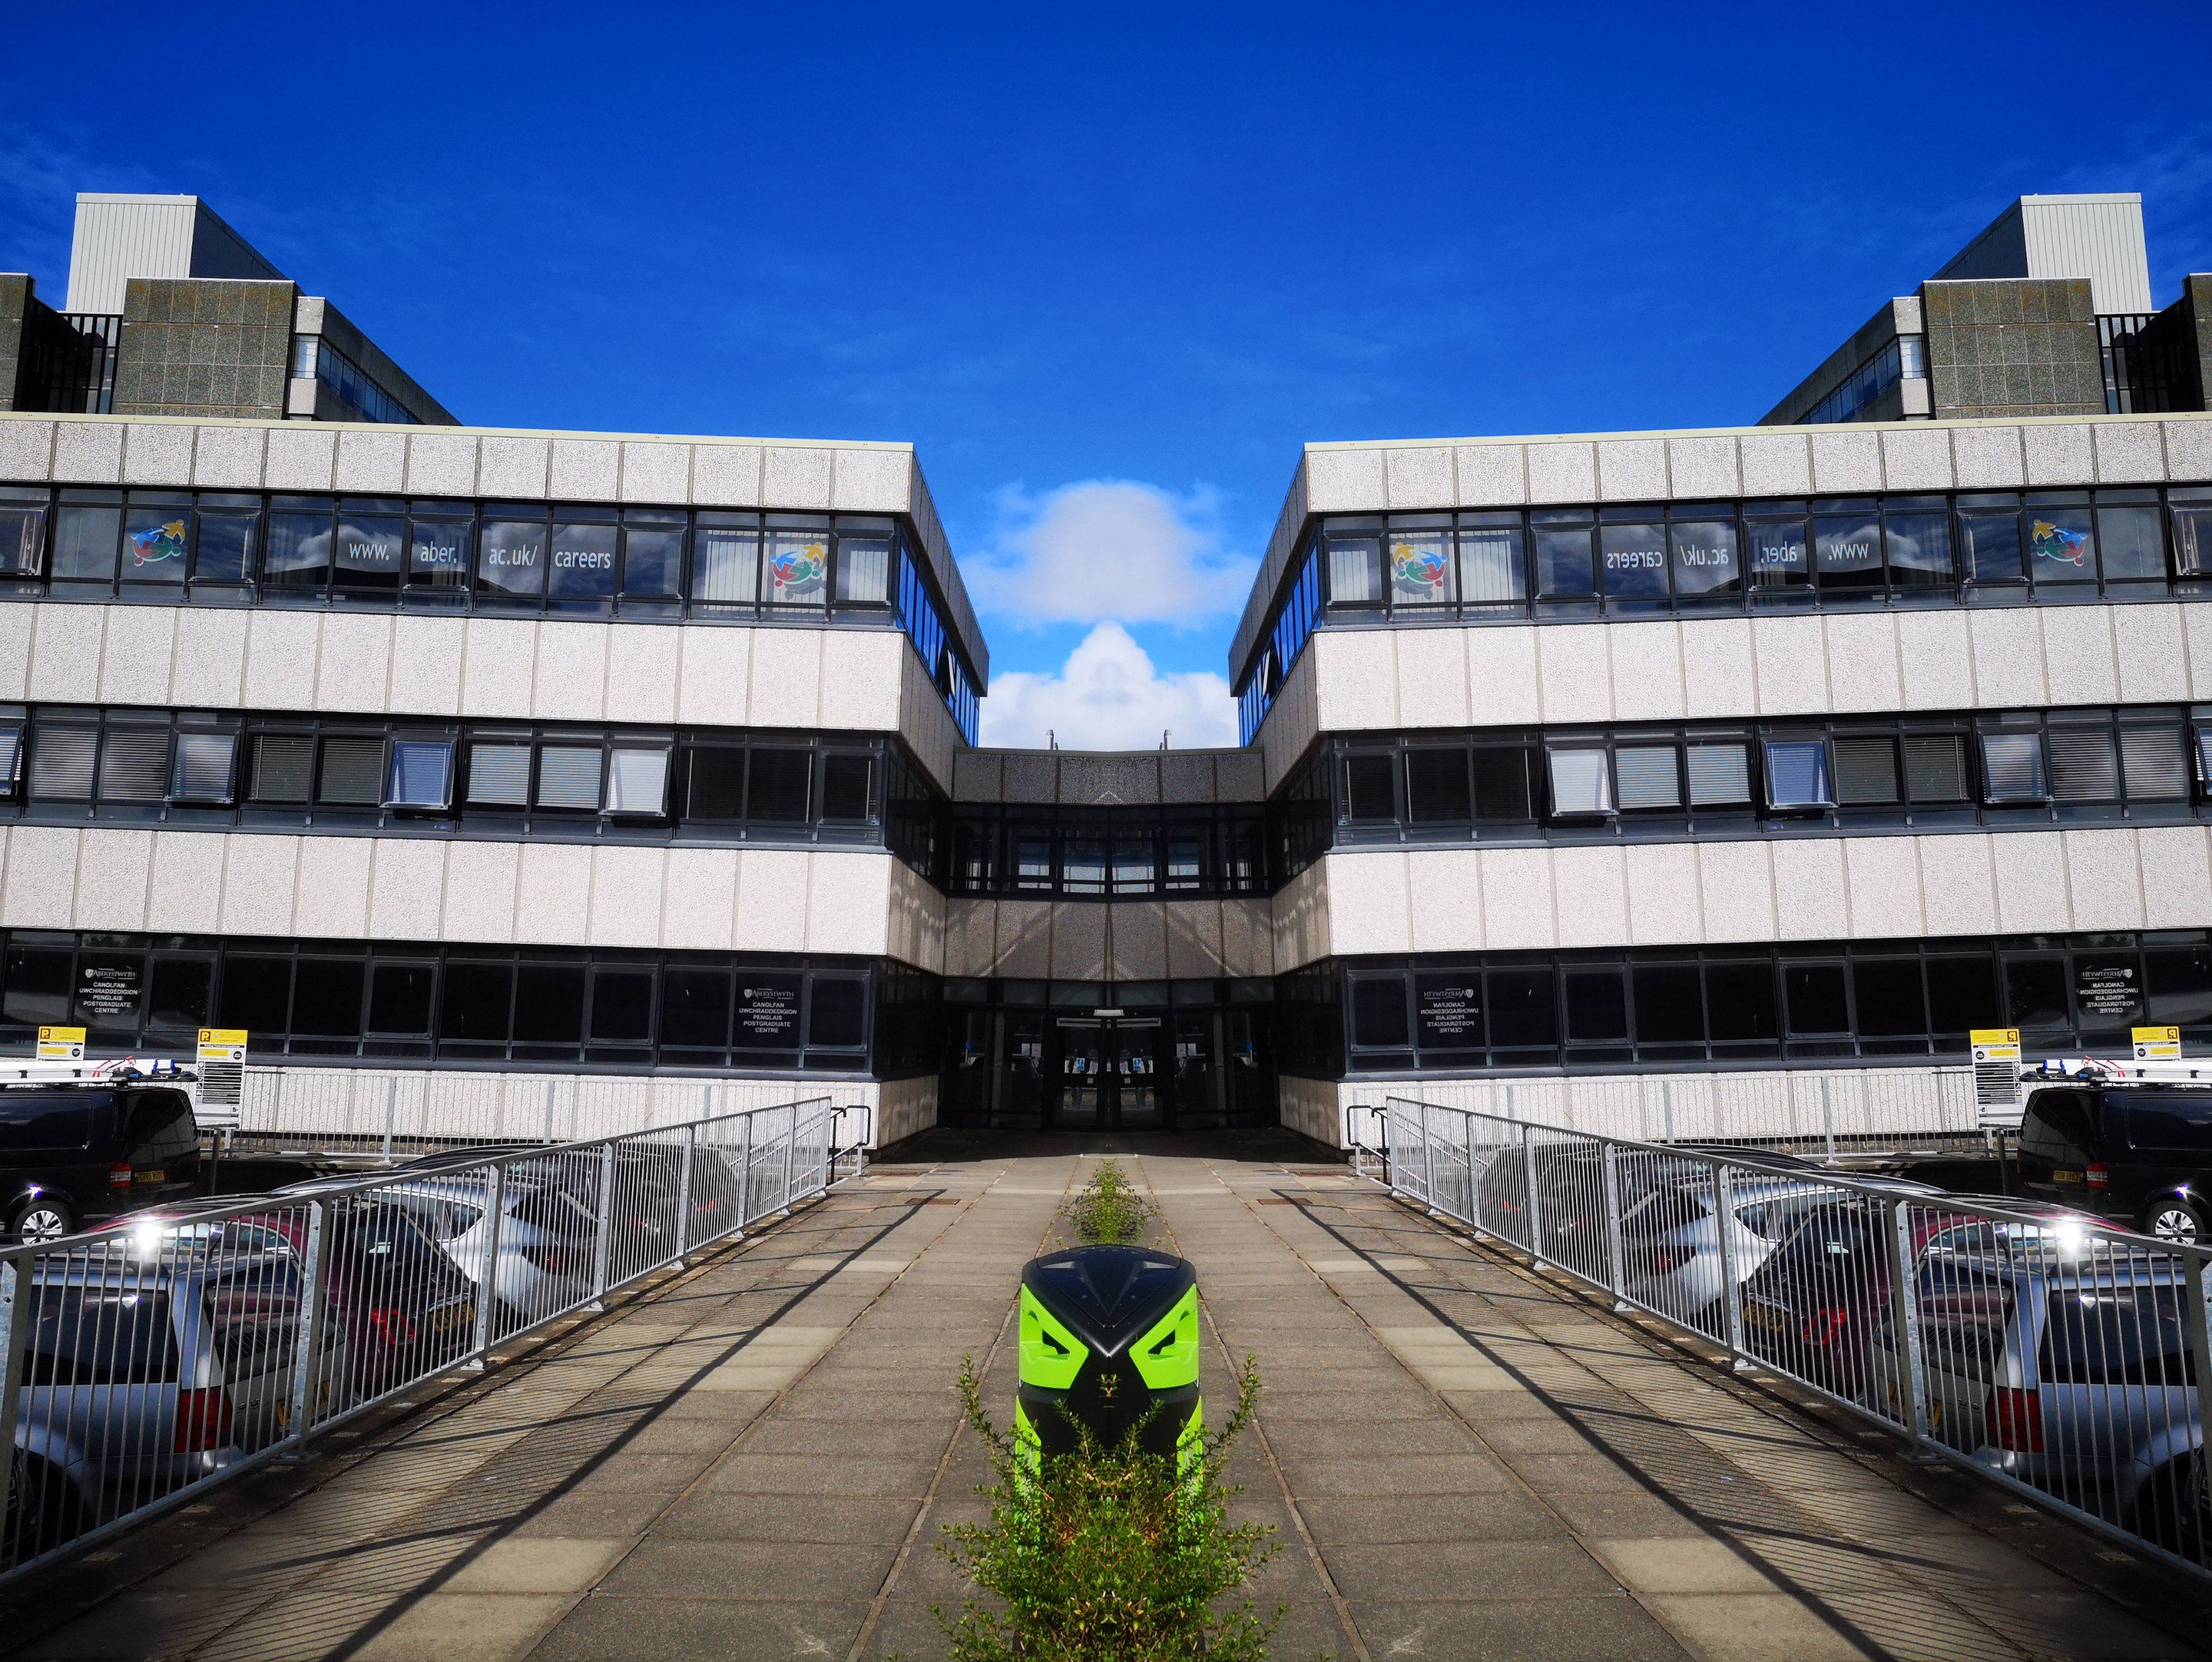
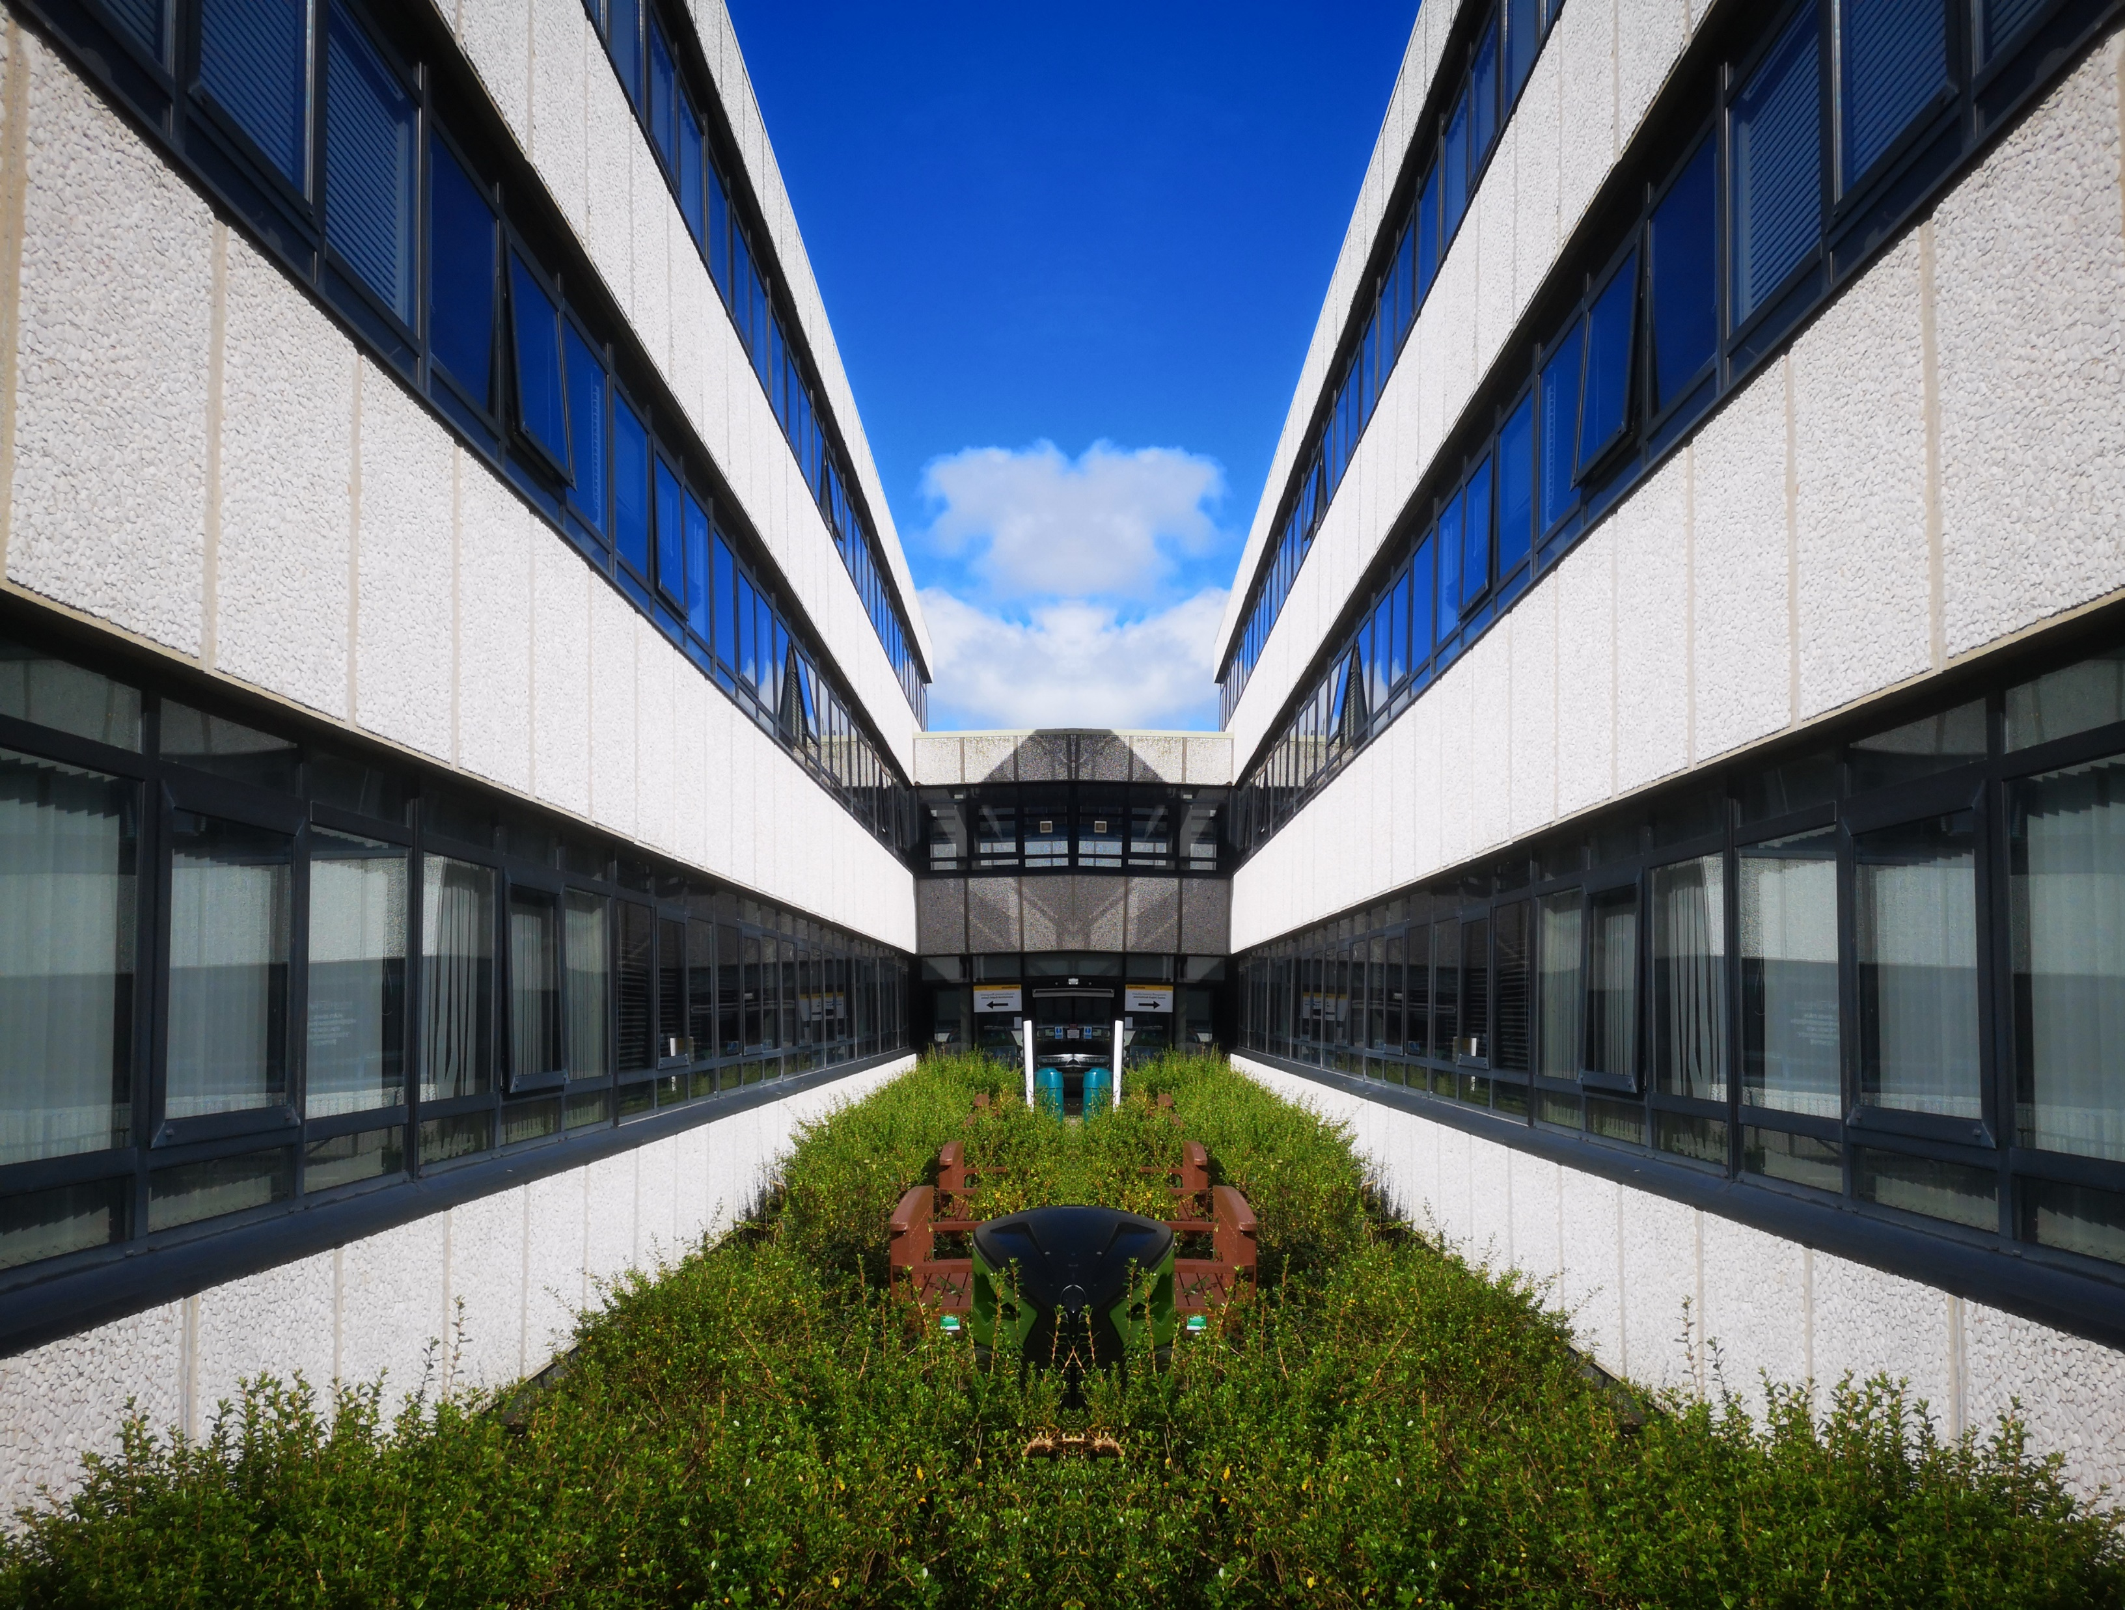
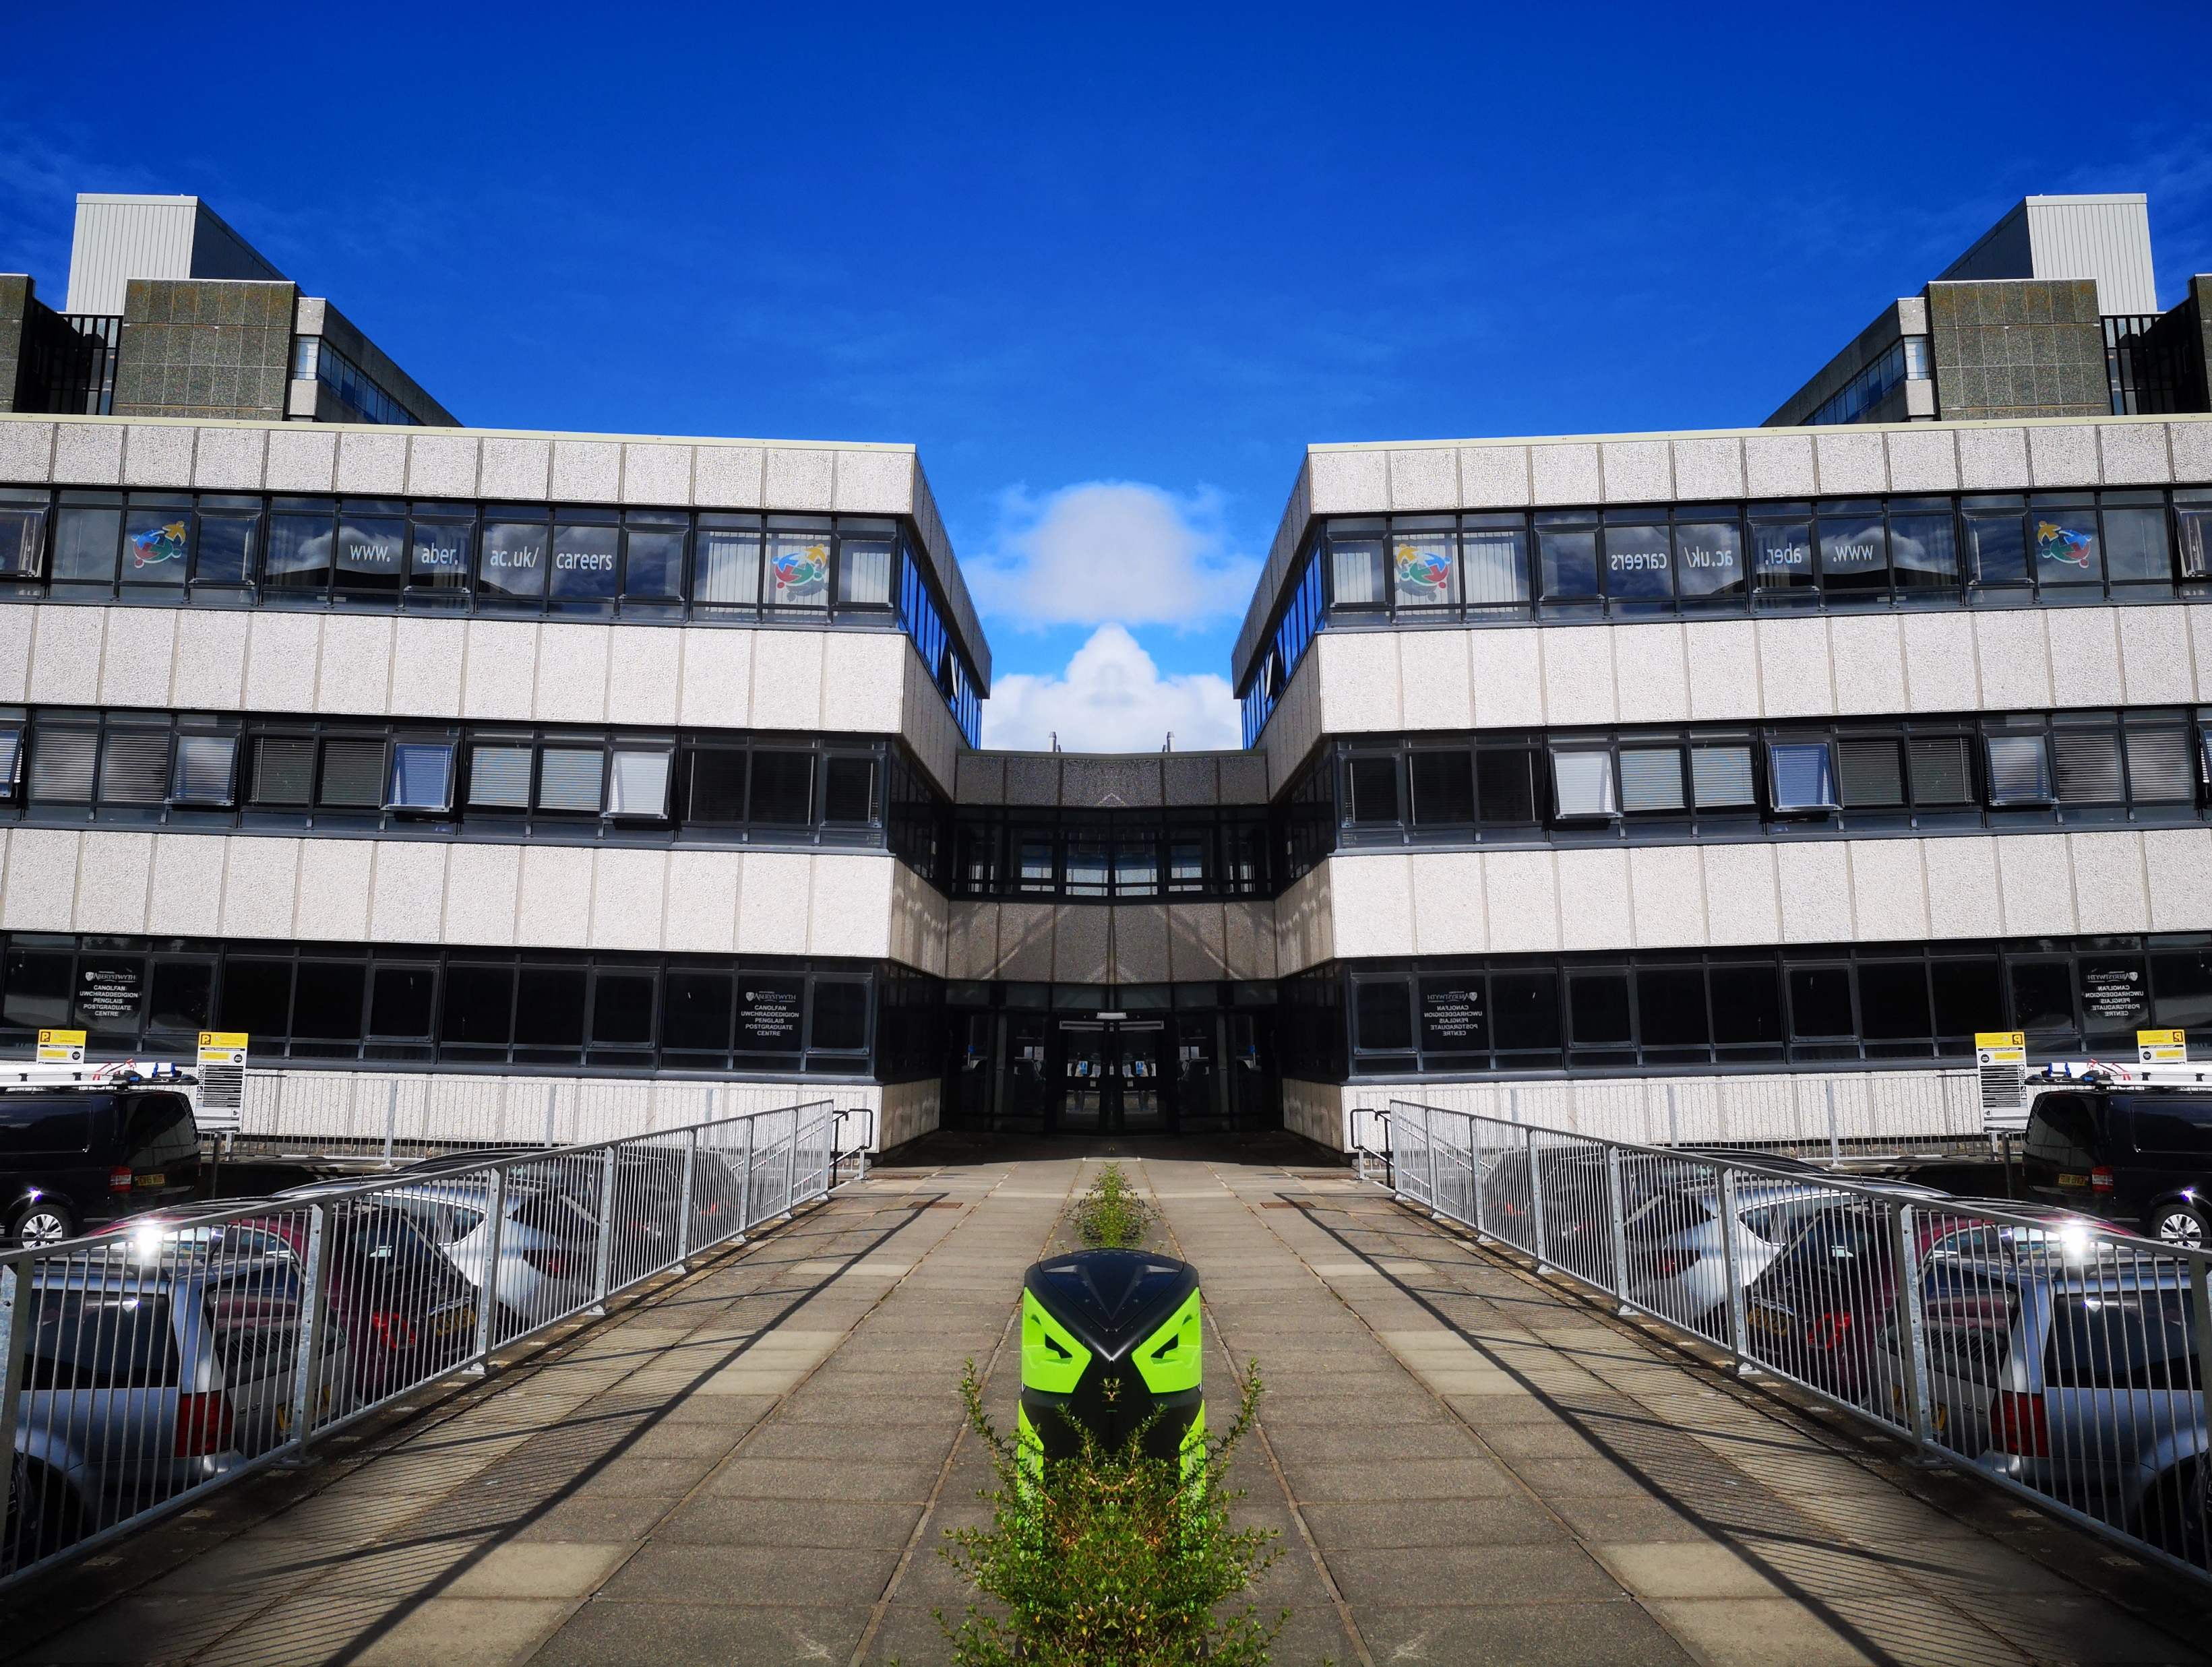
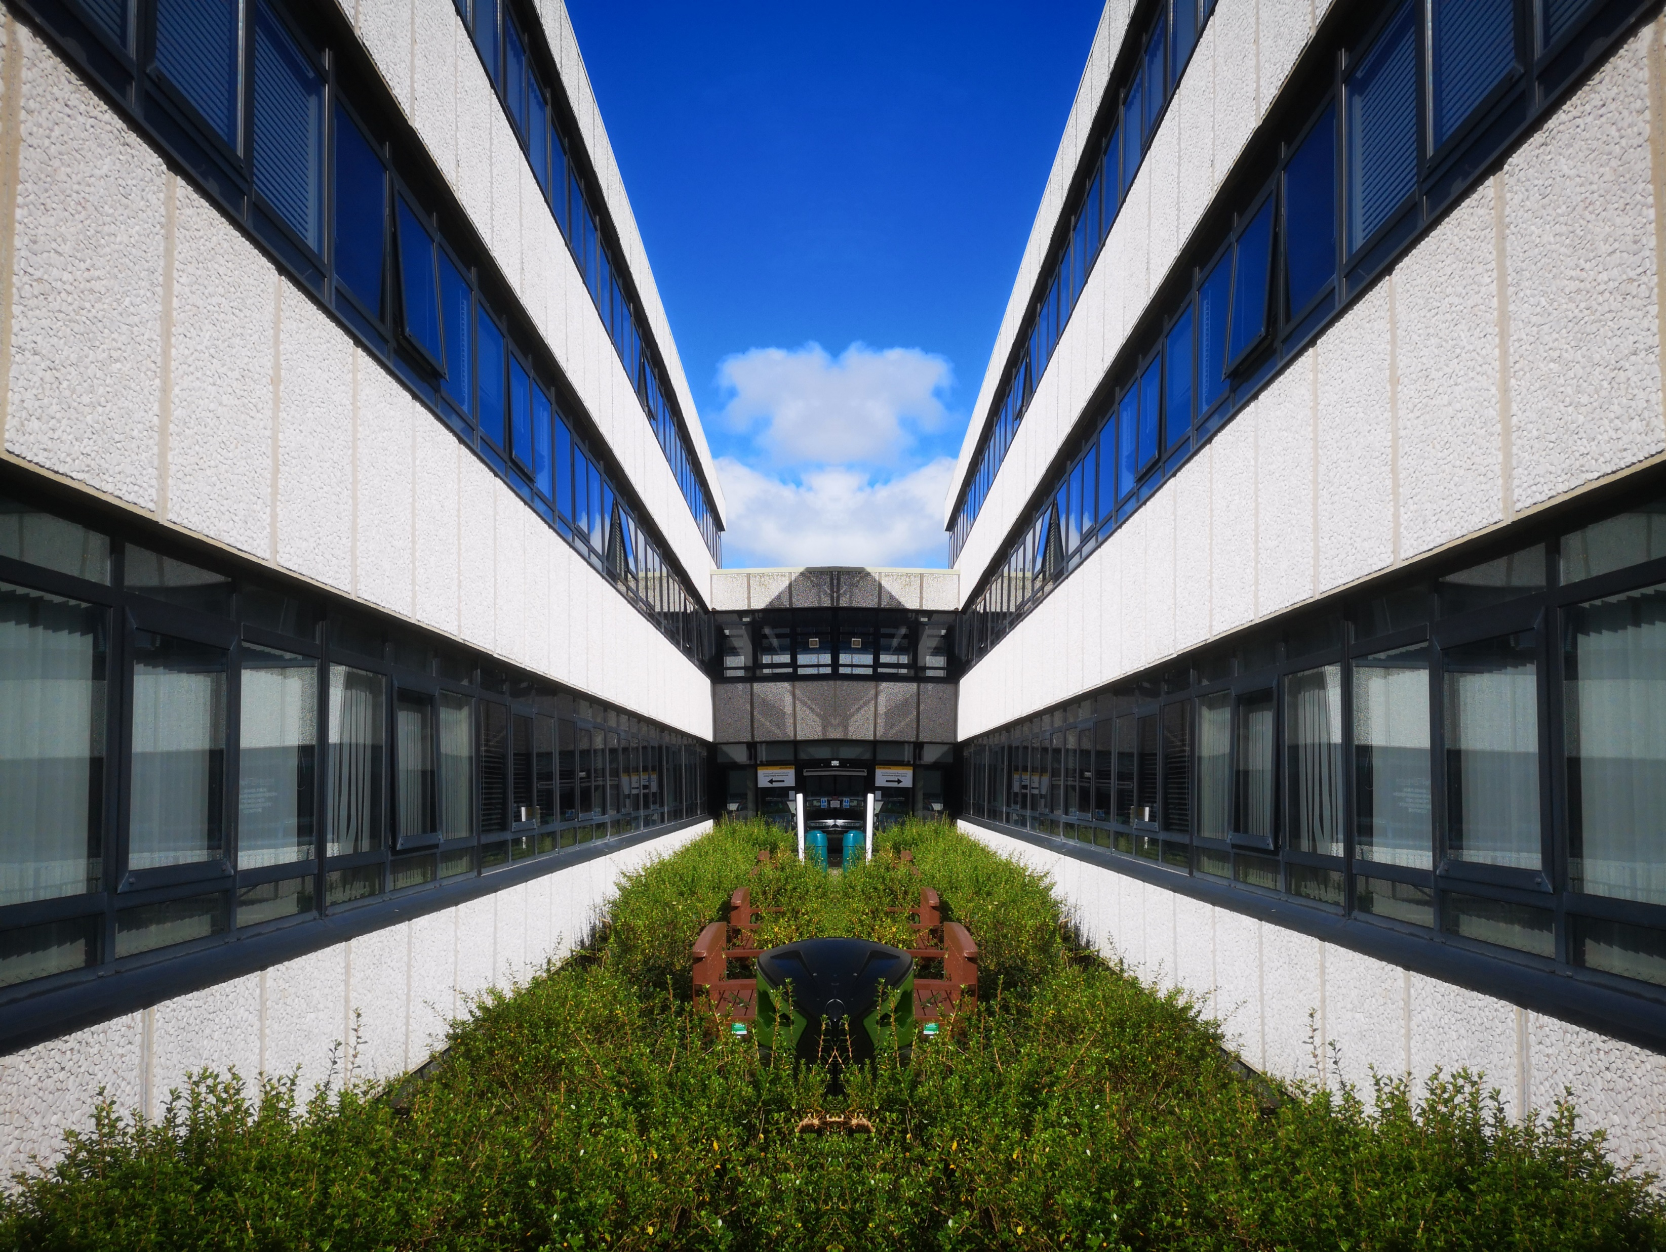
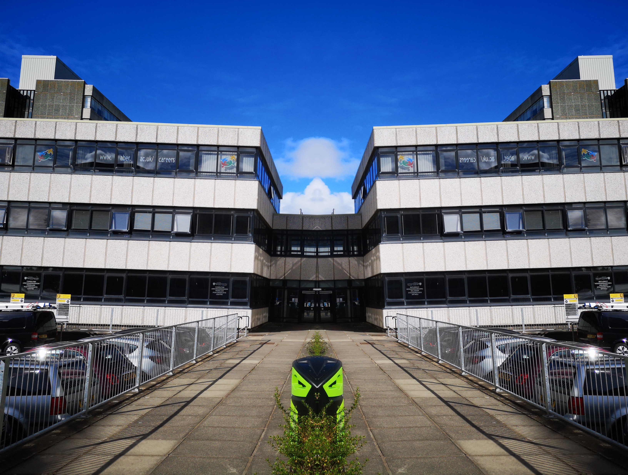
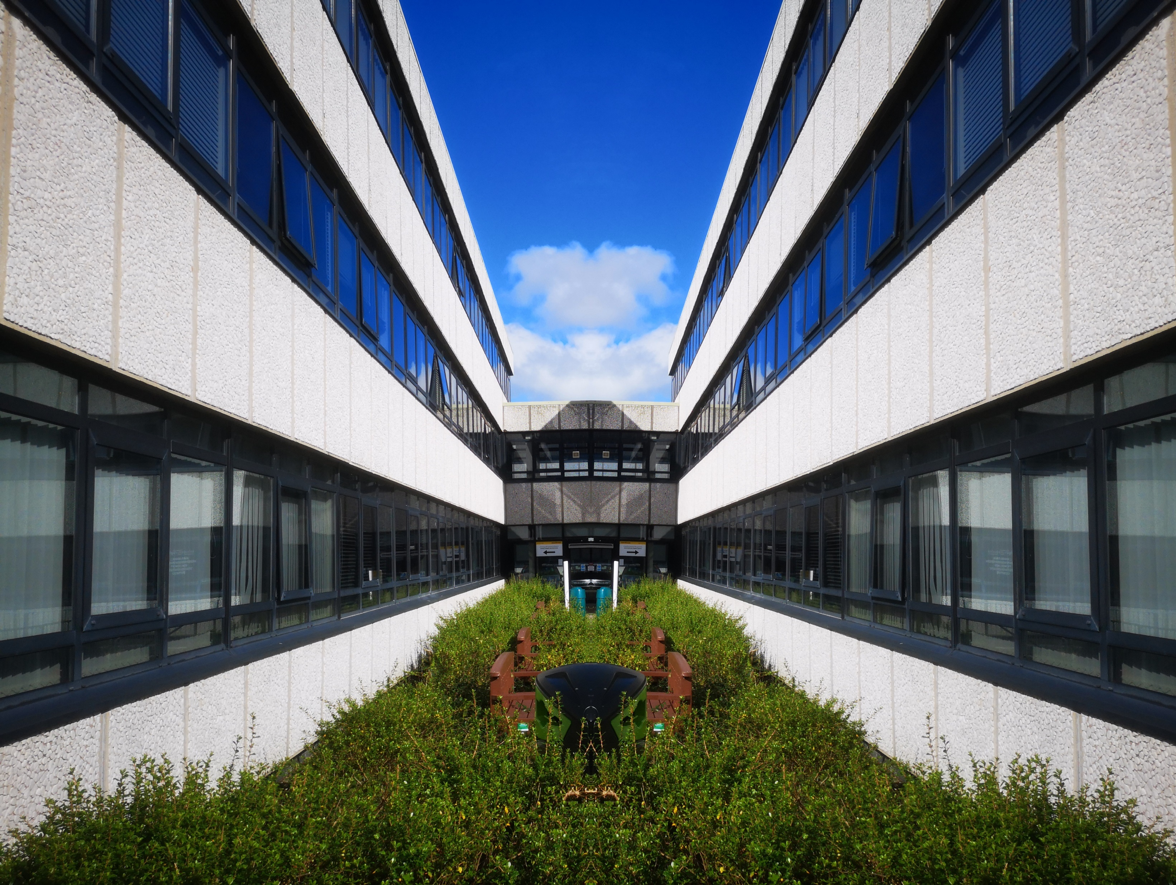
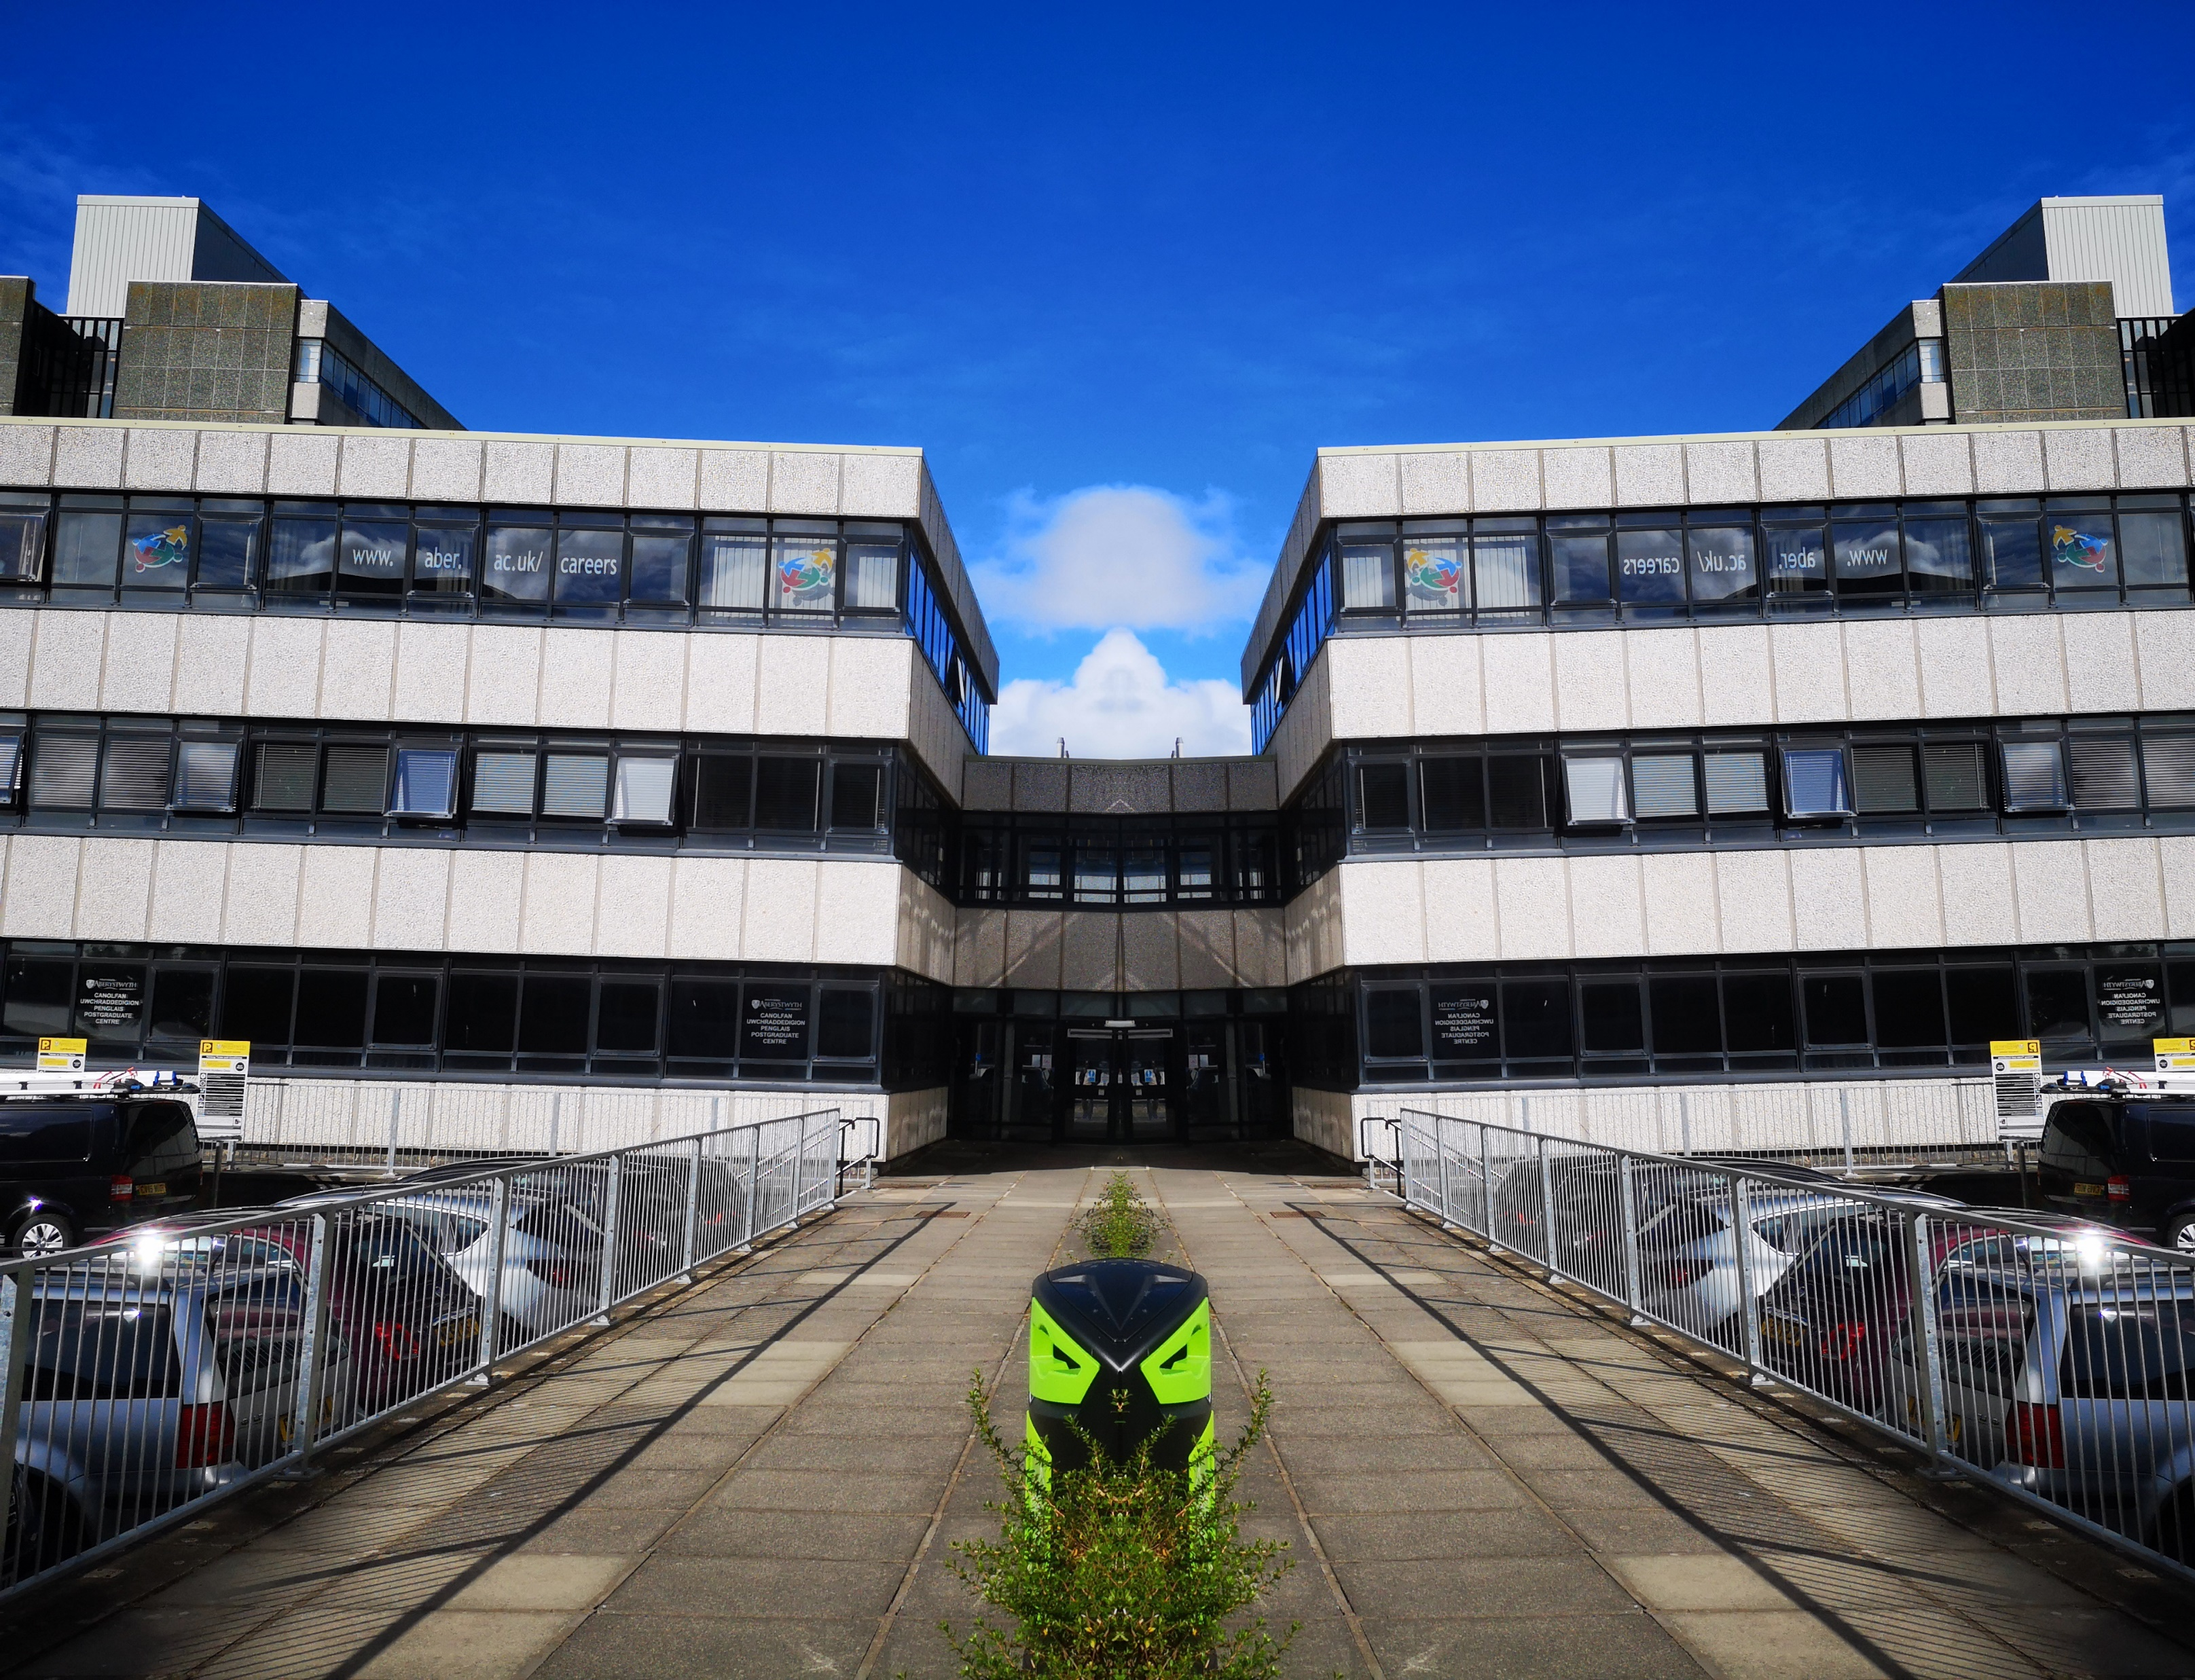

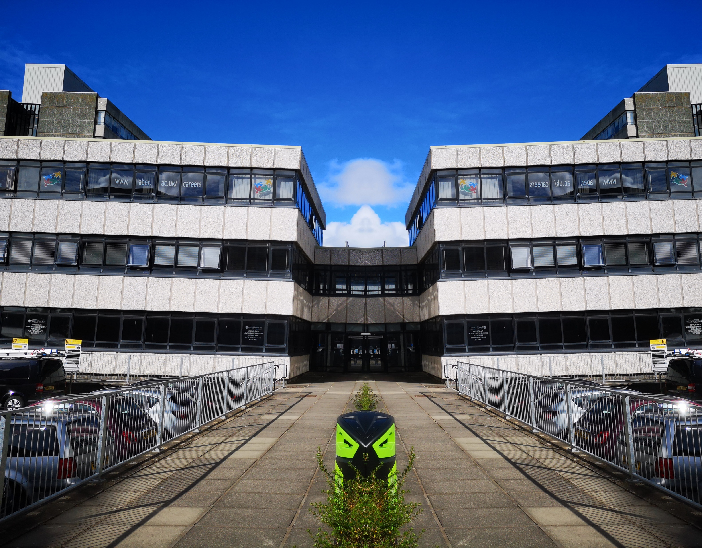
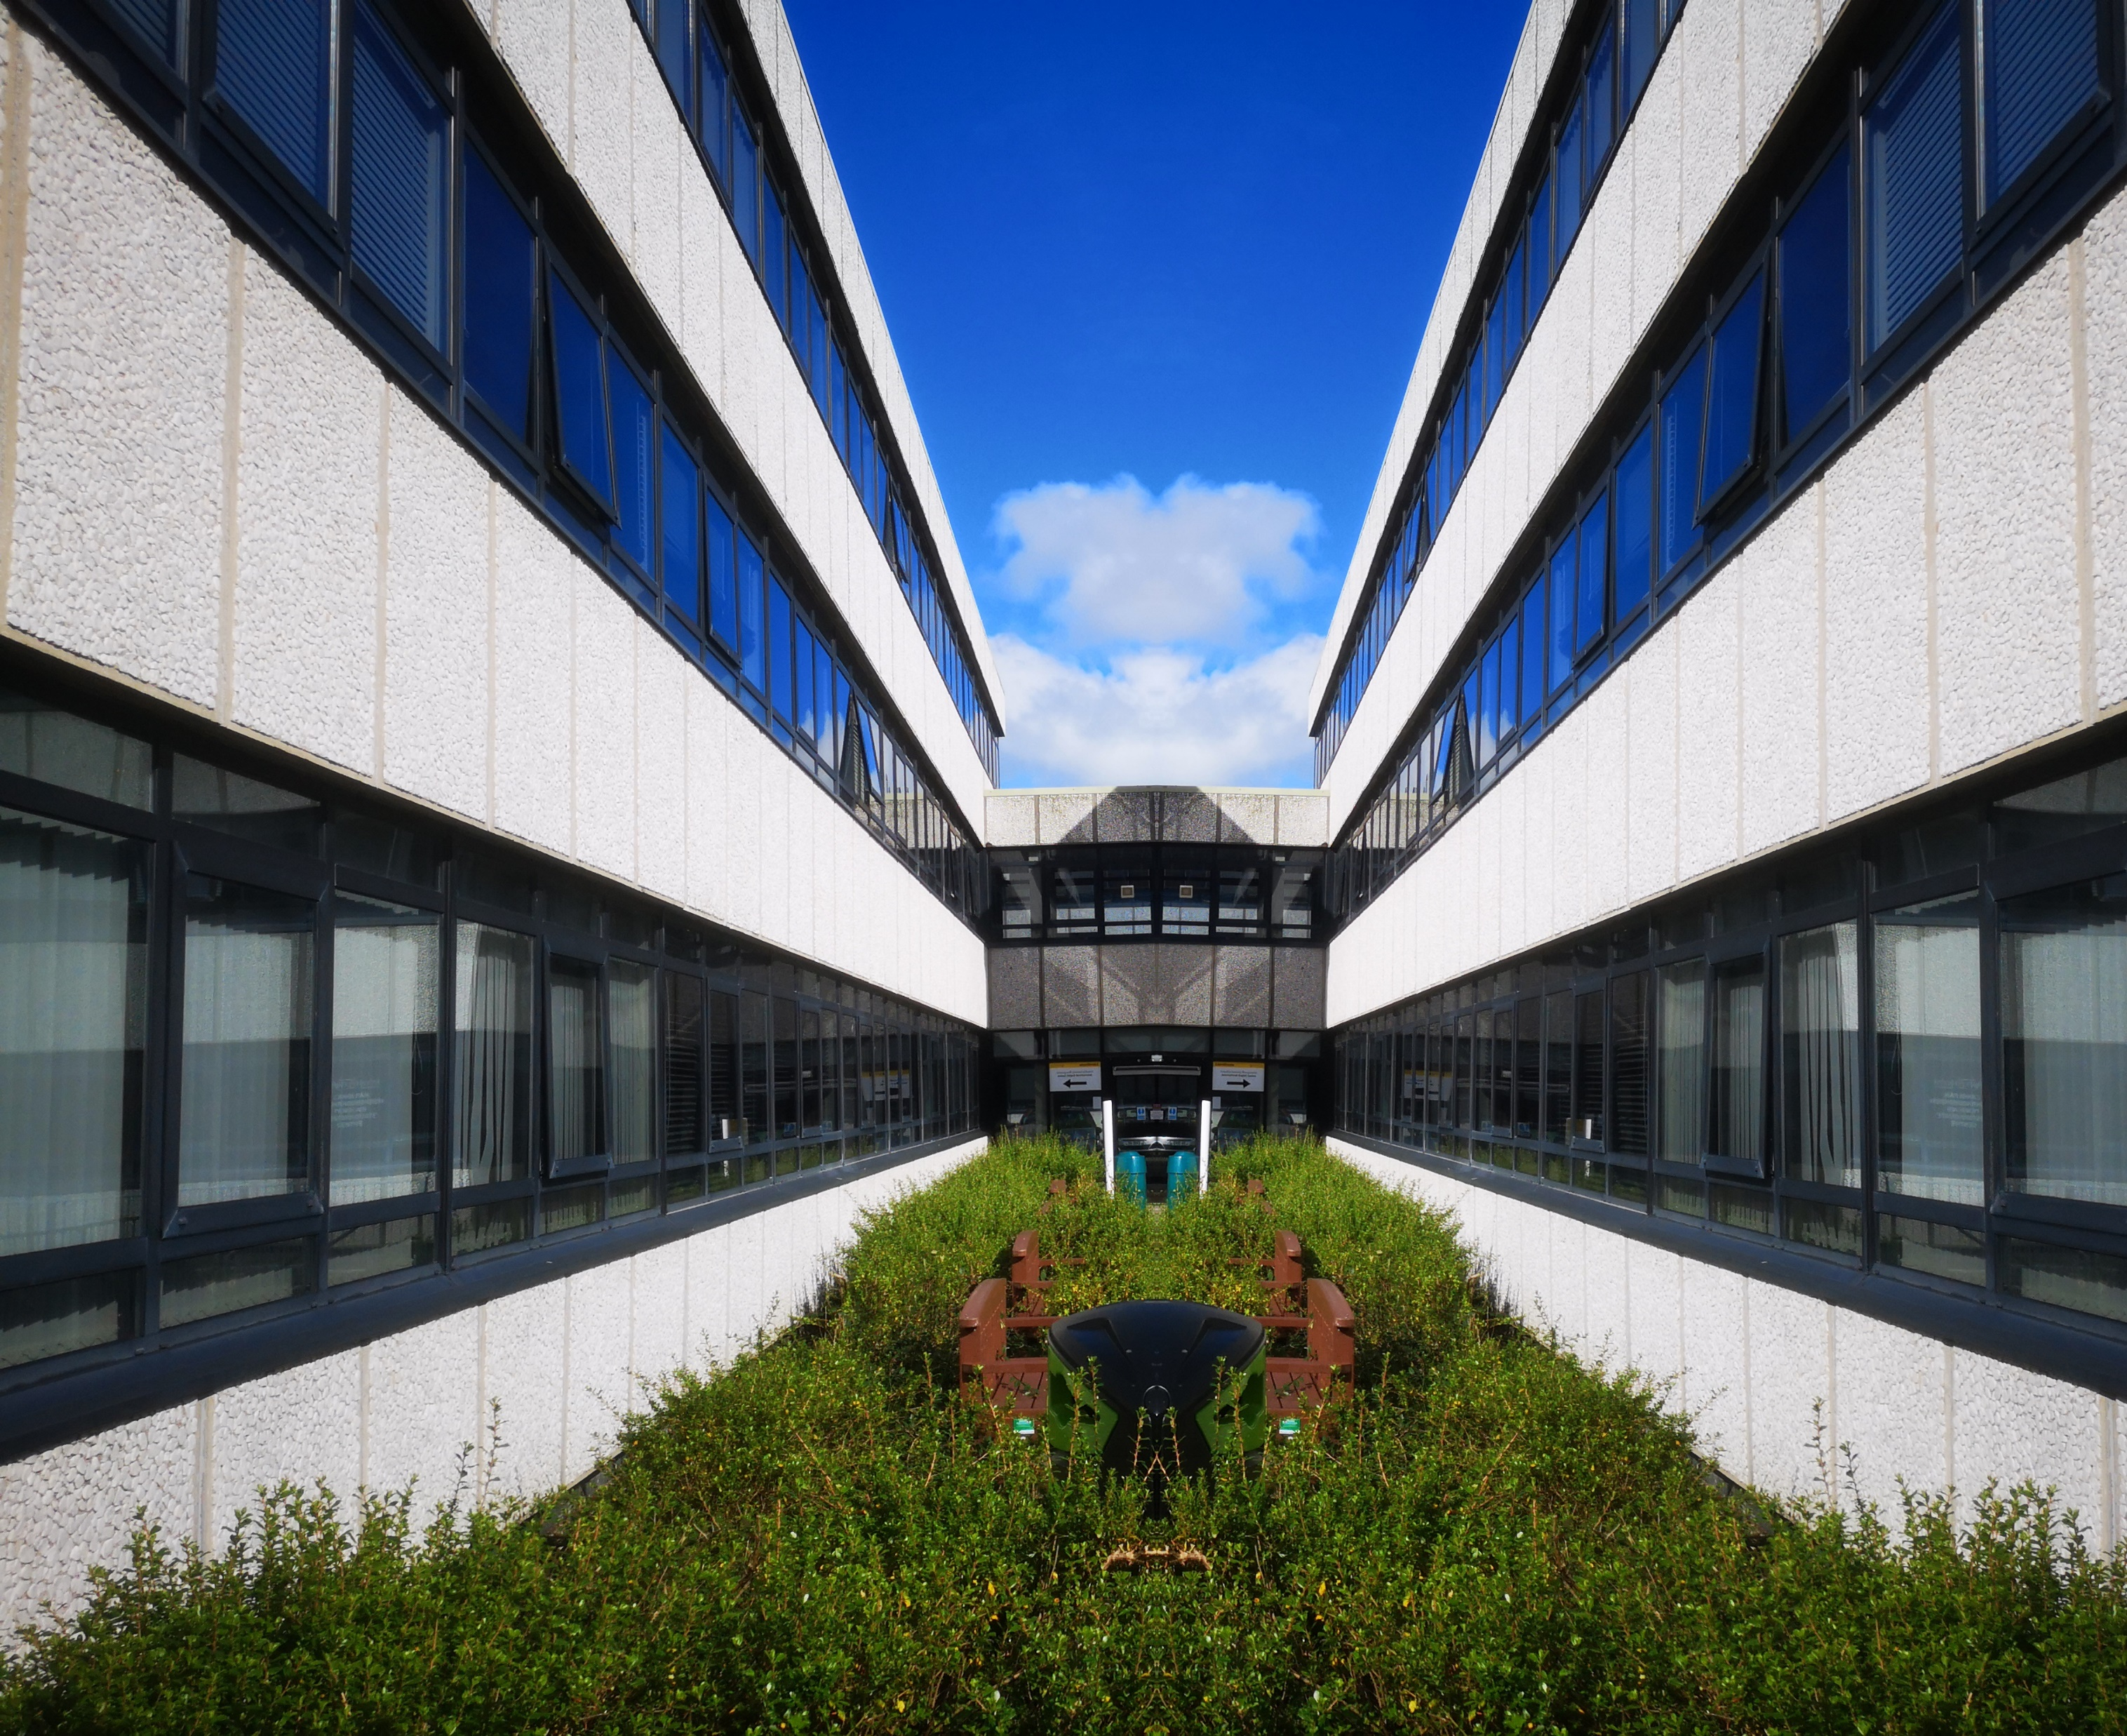
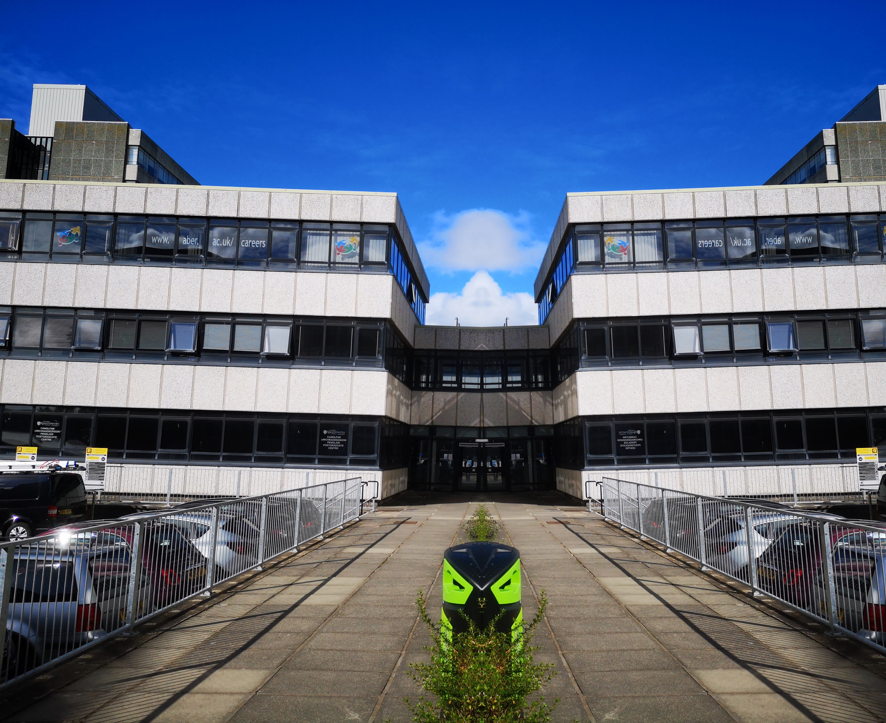
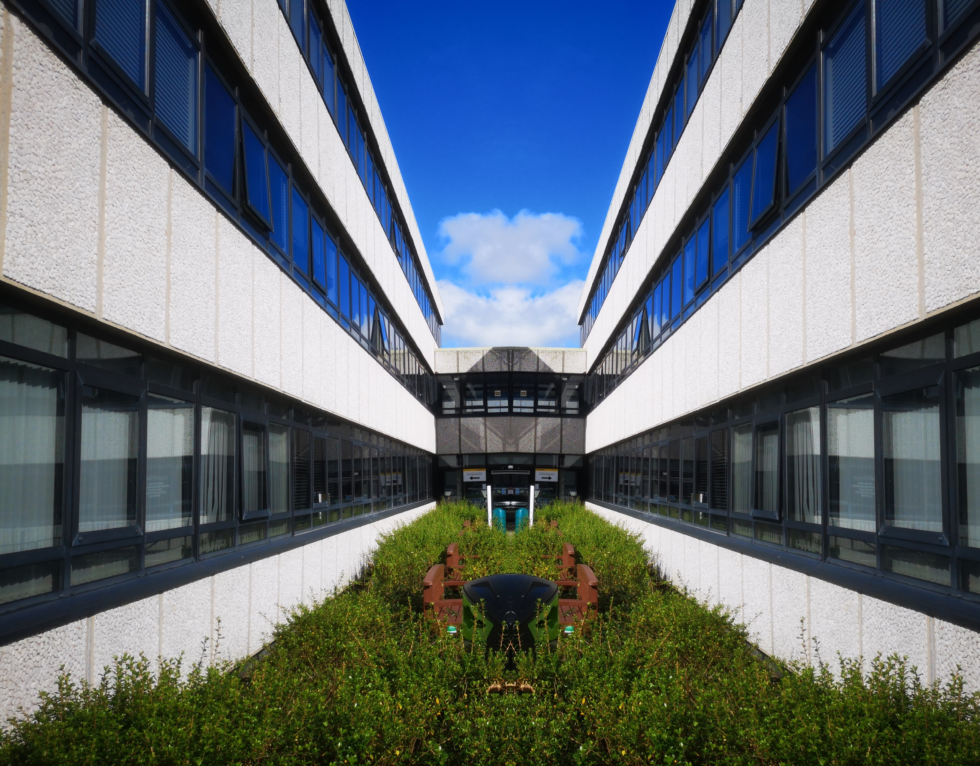
This slide demonstrates the different images in one set of the testing sets

Slide 6
Code Demo: symmetry.py

Slide 7
Testing symmetry.py
This slide shows the results of the testing, using all 170 images in my set

Slide 8
Where am I going?
Horizons
  Hough transform
Rule of three
Rule of thirds?

Slide 9
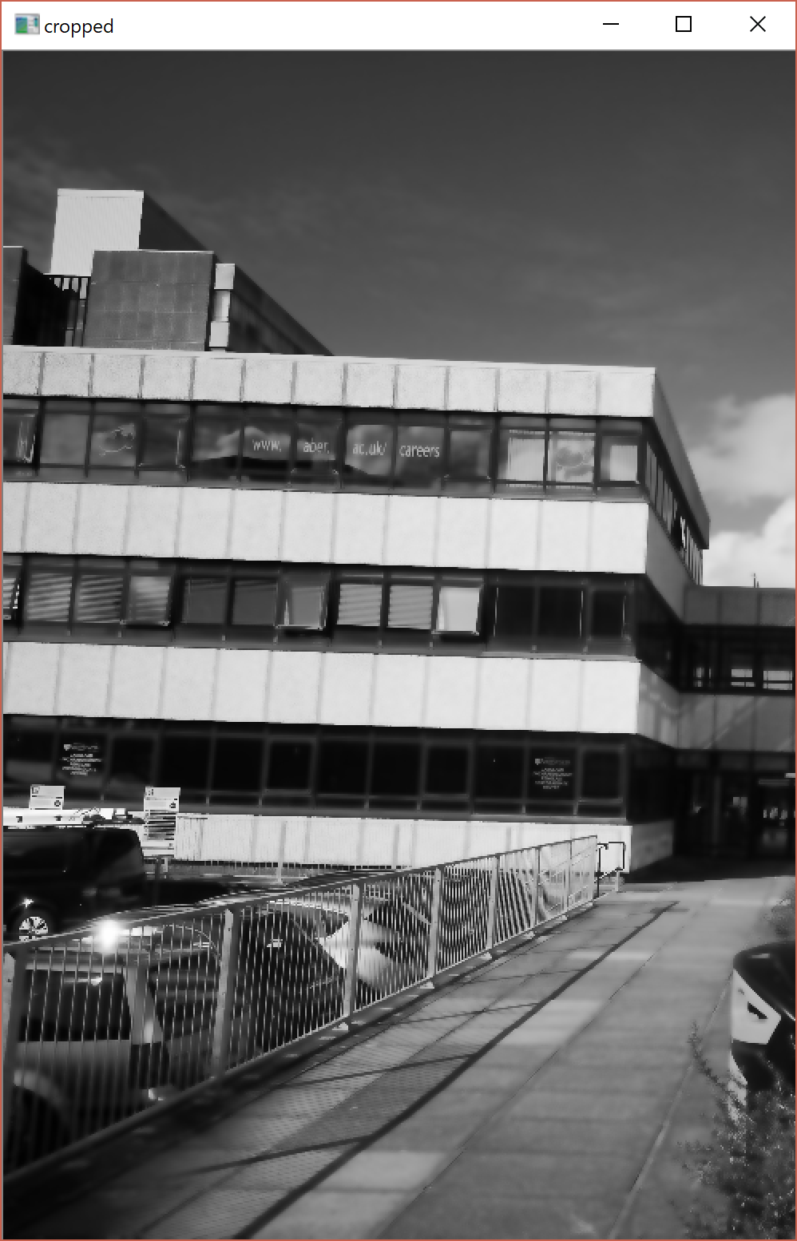
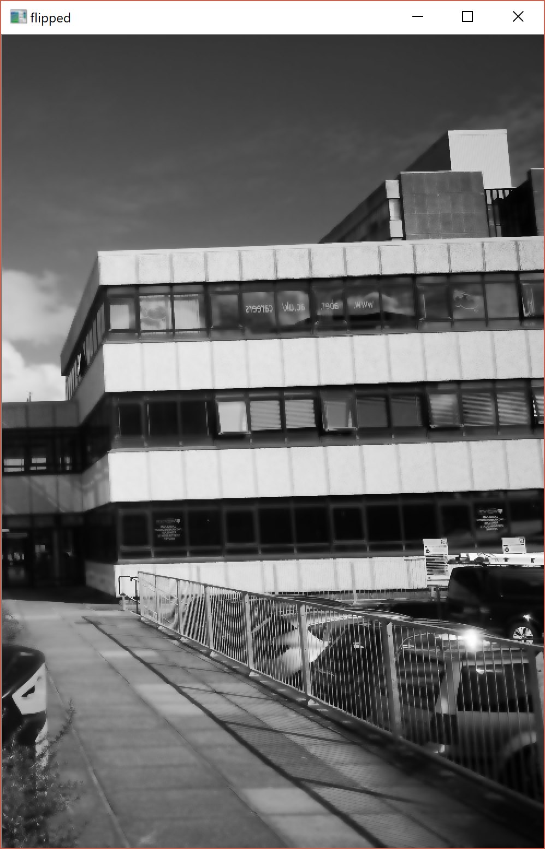
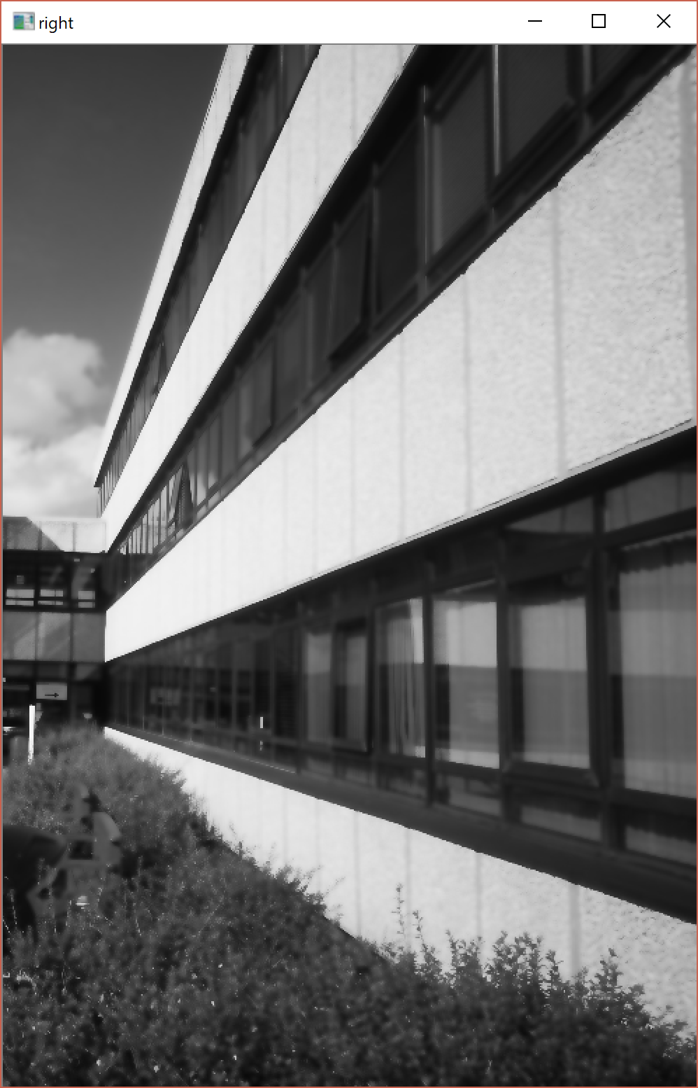
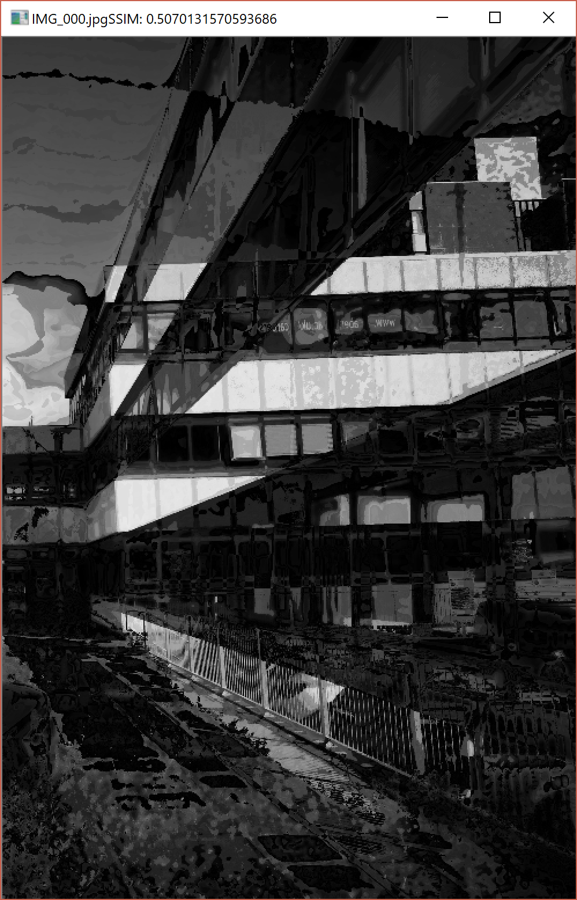
In case demo fails
This slide is only needed if your demo fails for whatever reason.

